Slide 1
Hidden Vulnerabilities in Google Play Store Apps
CS-GY – 9223 – Mobile Security
https://www.youtube.com/watch?v=4o2URWPtqX4
Michael Agee
maa9605@nyu.edu
Henry Post
hp2376@nyu.edu
04.14.24

Slide 2
Introduction
The Google Play Store is the official app store for devices running on the Android operating system. It serves as a centralized platform where users can discover, download, and manage various types of digital content, including apps, games, movies, TV shows, books, and music. Its most important elements with respect to security are:
Trust: Google implements robust security measures to protect users and their devices from malware and other security threats. Apps undergo a review process before they are published on the Play Store, and Google continuously monitors and updates its security protocols to ensure a safe environment for users.
Updates: The Play Store makes it easy for users to update their apps to the latest versions, ensuring they have access to new features, bug fixes, and security patches. Automatic updates can be enabled to streamline the process further.

Slide 3
Introduction
Security is paramount in the digital landscape due to the increasing reliance on technology in our daily lives. As we store sensitive information, conduct financial transactions, communicate, and access various services online, the need to safeguard our digital assets from threats such as cyberattacks, data breaches, malware, and other vulnerabilities becomes imperative.

Slide 4
Background
Several notable incidents and research findings have shed light on security vulnerabilities in Android apps over the years. Here are a few examples:
Exodus Spyware (2019): Researchers uncovered the Exodus spyware in 2019, which was being distributed through malicious apps on the Google Play Store. The spyware was capable of stealing a wide range of sensitive information from infected devices, including call logs, SMS messages, contacts, and device location. The incident raised concerns about the effectiveness of Google's app review process and the need for improved detection mechanisms to identify and remove spyware-infected apps from the Play Store
FakeApps Malware Campaign (2018): Researchers uncovered a widespread malware campaign on the Google Play Store dubbed "FakeApps" in 2018. The campaign involved hundreds of malicious apps masquerading as popular applications like WhatsApp and Minecraft. Once installed, these apps would display intrusive ads, redirect users to phishing websites, or even steal sensitive information from the device. The incident underscored the challenges of app vetting and the need for improved security measures to detect and prevent the distribution of malicious apps on the Play Store.

Slide 5
Background
Recent studies on the increases in secret exposure, show that despite the communication of industry best practices, exposed secrets in repositories and decompilable code are increasing.
“A comparative study of software secrets reporting by secret detection tools,” IEEE Conference Publication | IEEE Xplore, Oct. 26, 2023. https://ieeexplore.ieee.org/abstract/document/10304853
“Connecting the .dotfiles: Checked-In Secret Exposure with Extra (Lateral Movement) Steps,” IEEE Conference Publication | IEEE Xplore, May 01, 2023. https://ieeexplore.ieee.org/abstract/document/10174120

Slide 6
Methodology
App Selection and Tools Used

Slide 7
APK Selection
Our first task was to select apps from the Play Store that we deemed to be indicative of common apps. We divided our target apps into two groups, 10 most popular apps and a random selection of apps
10 Most Popular App:
Facebook, Messenger, Whatsapp, Instagram, TikTok, Facebook Lite, Telegram, SHAREit, Netflix, Snapchat
Random Apps:
Student Portal, QstudentConnection, Axis Mobile, BHIM Axis Pay, PrismHR, ClientApp, Verizon Client, AppFolio, Paycom, InteliChart

Slide 8
APK Harvesting
Direct downloading of APKs from the Play Store was not possible, so we had to use alternative means to harvest APK files. The use of free sites must be done carefully as apks can be refactored to include malware. We chose to use a website called “apkcombo.com”.
This tutorial was helpful:
How to Download an APK from the Google Play Store (howtogeek.com)
APK Downloader
APK Downloader - Download APK & OBB (Latest Version) (apkcombo.com)

Slide 9

APK Unpacking
APK files are not much more than just zip files with the compressed binaries and support files in the package. We could simply unzip these files using built-in decompression tools in Kali. However, some data loss can occur with this method. To get a more ordered and human readable file set we use a tool called `apktool`, and later used `jadx`.
We used the following command to unpack the APKs:

Slide 10
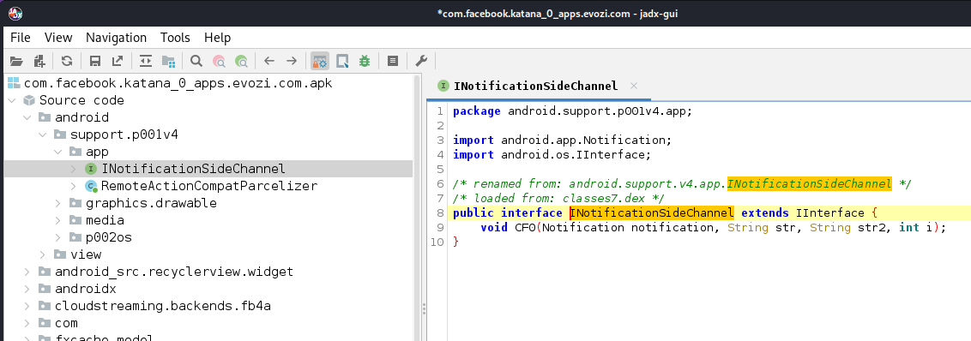
APK Decompiling
Once we were able to unpack the APK file we needed a way to decompile the .DEX files for inspection. We were most successful with the `jadx` decompiler. It has a GUI version as well that was very helpful. This tool needs to be configured to use more memory depending on the size of the DEX files.

Slide 11
Secrets and SAST Scanning
Scanning for secrets and SAST vulnerabilities source code can take hundreds of hours, if you’re looking at 10,000 lines of code and multiple vulnerability types possibly hidden in those lines.
In order to get a comprehensive scan of the code, we used multiple scanning tools.
Uploaded source code to individual public git repositories,
Used Snyk, `gitleaks`, and Gitguardian tools to search for secrets and SAST vulnerabilities,
Used `apkurlgrep` to search for API URLs

Slide 12
SAST and Secrets Scans

Slide 13
Findings – Classification
Both of our scanning services categorized vulnerabilities and secrets in to 4 groups which we present here. While the scanners found many vulnerabilities we focused only on the “Critical” ones.
The criteria is outlined below:
Level | Description
Critical | May allow attackers to access sensitive data and run code on your application
High | May allow attackers to access sensitive data in your application
Medium | Under some conditions, may allow attackers to access sensitive data on your application
Low | Application may expose some data that allows vulnerability mapping, which can be used with other vulnerabilities to attack the application

Slide 14
Findings – Distribution
The distribution of secrets found among the APKs can be seen on the right.
App Name | Secrets | Critical | High | Medium | Low
Student Portal | 0 | 0 | 0 | 0 | 0
Q StudentConnection | 0 | 0 | 0 | 0 | 0
Axis Mobile - Corporate | 3 | 0 | 5 | 18 | 10
BHIM Axis Pay | 0 | 0 | 10 | 59 | 9
PrismHR Employee Portal | 0 | 0 | 0 | 10 | 5
ClientiApp - Client management | 0 | 0 | 0 | 28 | 3
AppFolio Property Manager | 0 | 0 | 5 | 15 | 4
InteliChart Patient Portal | 0 | 0 | 4 | 9 | 1
Verizon Business Group Network Vendor Portal | 0 | 0 | 0 | 2 | 0
Paycom Software, Inc. Paycom | 0 | 0 | 0 | 1 | 0
WhatsApp | 4 | 1 | 12 | 100 | 16
Facebook | 16 | 4 | 0 | 0 | 0
Messenger | 19 | 6 | 17 | 96 | 16
TikTok | 22 | 1 | 15 | 145 | 62
Instagram | 121 | 4 | 8 | 48 | 28
Facebook Lite | 0 | 0 | 2 | 5 | 3
SHAREit | 4 | N/A | N/A | N/A | N/A
Netflix | 0 | N/A | N/A | N/A | N/A
Snapchat | 1 | N/A | N/A | N/A | N/A
Telegram | 1 | 0 | 0 | 26 | 12

Slide 15
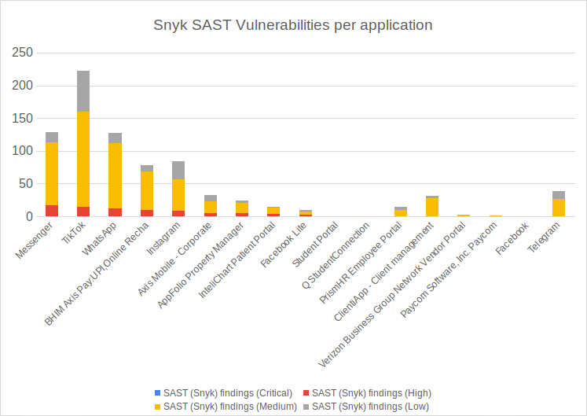
Findings – SAST Findings
Here you can see a distribution of SAST findings, by type, over each application.

Slide 16
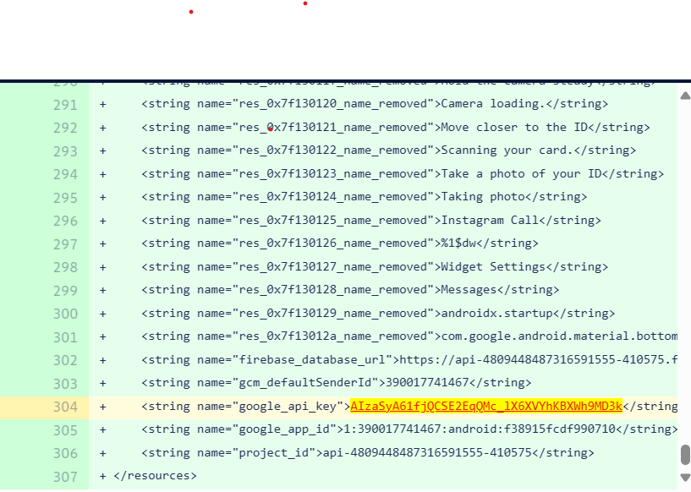
Findings – Example of Critical Secret
A Google API key found. An attacker can use this to abuse the API by sending commands directly to it like the following string:
https://maps.googleapis.com/maps/api/geocode/json?address=ioki%20gmbh&key=[GOOGLE_API_KEY]

Slide 17
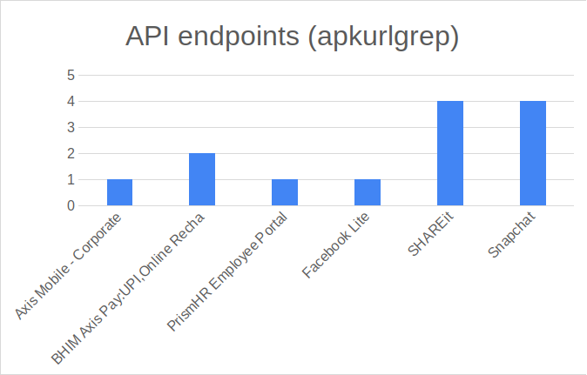
Findings – API Endpoints
Here is a graph that shows embedded API URLs within APK files.
Axis Mobile - Corporate
idpm.axisbank.co.in - Running an HTTP server
BHIM Axis Pay:UPI, Online Recha
`upiuat.axisbank.co.in/v1/`
/v1/bank/transactions/pay
...etc
PrismHR Employee Portal
Found 1 URL: https://epycorp-ep.prismhr.com/apis/ep/peos?fwdClientCode=
Seems to be used with a URL parameter. We could probably fuzz the fwdClientCode parameter.

Slide 18
Discussion: Can Android APK Secrets Be Made Safe?

Slide 19
Prior Research
Our finding seemed to coincide and reinforce the findings of some earlier research would took a much wider sample of git repositories. In a paper from 2022 paper[1], researchers found nearly 200,000 API keys and tokens checked into the repositories.
However, our research focuses on decompiled binaries. Recent research suggest that this is no safer than a private repository unless secure coding techniques are used and enforced. [2]

Slide 20
Challenges Of Mitigation
There are few good alternatives with when trying to secure secrets in your code, they have all have their costs:
Encryption – Encryption has a cost in processor cycles and a cost of complexity to implement.
Limiting Resources – We can limit apps to only retrieve secrets when on trusted networks, however, this limits functionality.
Additional Authentication – This could mean MFA or the user provides additional credentials to verify the requesting apps is legitimate.

Slide 21
Best Practices
Current research suggest the some best practices that may mitigate secret exposure in binaries:
Server-side Implementation – Don’t allow mobile apps to directly connect to 3rd party apps.
Short-Lived Secrets – Rotate keys frequently
External Secret Management – Store secrets in an external, secure secrets vault - i.e. Hashicorp Vault, CyberArk, etc.

Slide 22
Conclusions

Slide 23
Conclusion
Despite numerous studies and efforts to address the issue, exposed secrets in source code repositories persist. Our research has identified several factors contributing to this trend:
Developer education and awareness are crucial
Insufficient code reviews (especially in legacy codebases)
Compliance with security standards
Continuous monitoring and scanning of code repositories

Slide 24
Conclusion – Future Mitigations
Future mitigations might include:
Increased Regulation
More expensive liability and cybersecurity insurance to non-compliant developers
Third party code repository monitors
Enforced SAST/Secrets code scanning of all Android applications, before being released to the Google Play store.

Slide 25
Conclusion – Additional Research
From these conclusions we can see there needs to be some additional root cause analysis of the issue. Possible research topics could include:
Management of KPIs in Software Development
Executive Policy in Secrets Management
Developer Understanding of Secrets Risk
An automated workflow for scanning, review, and remediation

Slide 26
Conclusion – Additional Work
Our processes were somewhat manual in this research project...
In the future, these processes could be automated and chained together:
Downloading APK files
Decompiling it with `jadx-gui`
Running Snyk, gitleaks, apkurlgrep on the source code
Run `nmap` on the API URLs
Run pentesting tools, DAST scanners on the API URLs

Slide 27
Citations
[1] “Security Analysis on Android Application Through Penetration Testing using Reverse Engineering,” IEEE Conference Publication | IEEE Xplore, Mar. 01, 2023. https://ieeexplore.ieee.org/abstract/document/10127653
[2] “Detecting and mitigating Secret-Key leaks in source code repositories,” IEEE Conference Publication | IEEE Xplore, May 01, 2015. https://ieeexplore.ieee.org/abstract/document/7180102
[3] “What are the Practices for Secret Management in Software Artifacts?,” IEEE Conference Publication | IEEE Xplore, Oct. 01, 2022. https://ieeexplore.ieee.org/abstract/document/9973029/author

Slide 28
Source code/workflow
See https://github.com/meltingscales/NYU-CS-GY-6xxx-mobile-security-final-project for:
Source code, scripts
Workflow for decompiling and scanning APKs
Individual APK files
Breakdown of API URLs
Breakdown of secrets findings
Breakdown of SAST findings

Slide 29
Thank you!

